Slide 1

Man Vs Machine

Slide 2
Research Objective
Analyze if a Random Forest (machine learning) model or an Artificial Neural Network can establish better trading rules (using various statistical and technical indicators) than the traditional algorithms current used in the market

Slide 3
Asset Classes Used
Stocks Indices – Russel2000 and S&P500
Commodity – Oil and Gold
Foreign Exchange – EUR/USD and GBP/JPY
Crypto – BTC and Ethereum

Slide 4
Traditional Trading Strategies
MACD (Trend)
Impulse System
RSI (Oscillator)
Bollinger Bands (Volatility)

Slide 5
ML Strategies
Random Forest
Raw Indicators
30 day rolling z-score
Normalized Indicators
Artificial Neural Network

Slide 6
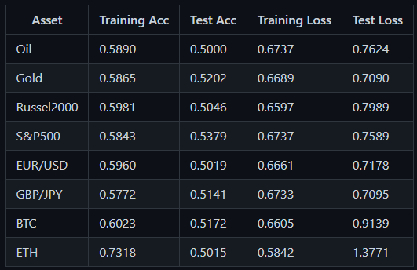
ANN Accuracy and Loss Scores

Slide 7
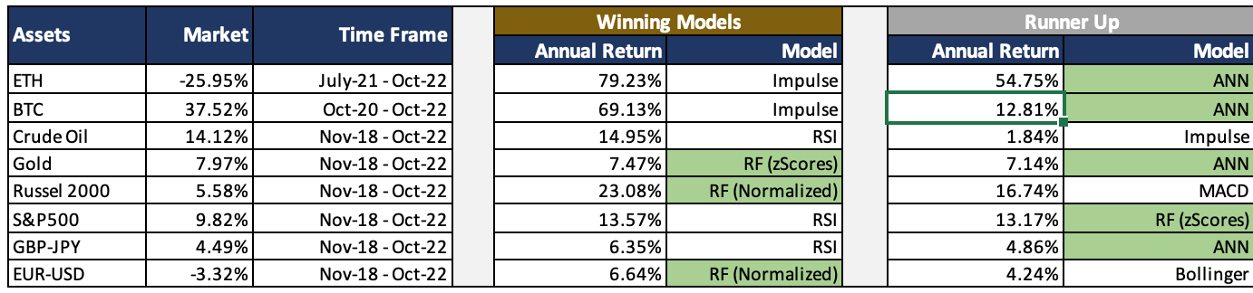
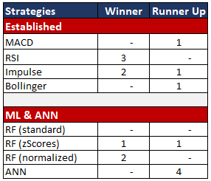
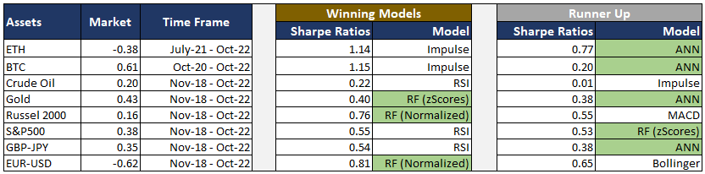
Research Output

Slide 8
Conclusion
Look to enhance the ML/ANN model returns by incorporating probability of signals into the strategy.
Incorporate risk limits (such as trade stop/loss) into the system to hopefully reduce volatility and increase Sharpe Ratio.
Endless possibilities and we hope to have set the foundation for further research in this topic!

Slide 9
Questions

